Slide 1
ASSESSMENT: RICKY’S RIDES
Portfolio for 3.7 / 3.8
LUCAS POWER

Slide 2
CREATE PROJECT MANAGEMENT TOOLS
Notes:
Share the link here

Slide 3
STEP 1 : DEFINE YOUR RELEVANT IMPLICATIONS
What are 3 relevant implications you will be focusing on?
Aesthetics
Usability
Functionality

Slide 4
STEP 1 : DEFINE YOUR AUDIENCE
Who is your target audience?
Kiwis in New Zealand who want to rent a car
How are they most likely going to be viewing your GUI?
On mobile, than pc than ipad.

Slide 5
DEFINE THE KEY STEPS OF THIS PROJECT
Record the client specifications
Create Trello board to manage tasks
Ideate (wireframe (GUI), Google fonts / colours)
Prototype: Create the GUI, test inputs work, perform calculations, test outputs, form validation and error messages, create firebase project, connect to firebase and push data
Testing : ongoing and should involve A vs B testing with end users

Slide 6
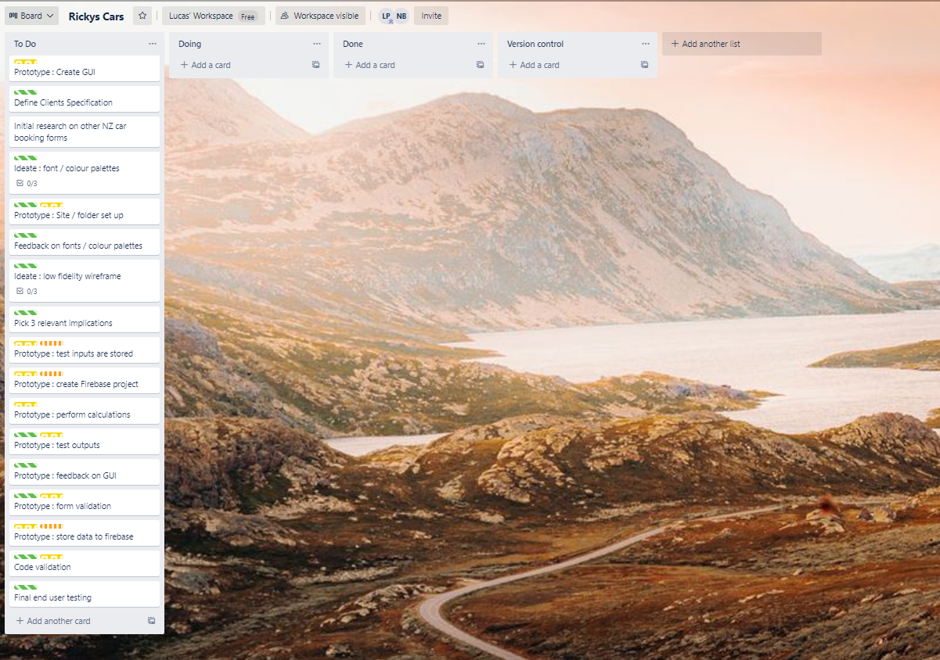
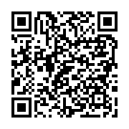
PROJECT MANAGEMENT TOOL: TRELLO
https://trello.com/invite/b/l0Z50WLb/2fea62399937c79b473bfab548914a71/rickys-cars

Slide 7
CLIENTS SPECIFICATIONS
The Programs Specifications
The top of the page must contain their Company name and logo heading
A footer containing their contact details
The GUI should clearly display each of the vehicles with a photo, daily hire price and their corresponding description
The user should then be allowed to select a vehicle
Allow users to select from extra options (listed above)
Select their number of days – number input (max 21)
Pick up date – date input
Pickup location – Dunedin Airport or Ricky’s Rides Depot (radio buttons)
A reservation summary which outputs the detail of their reservation with an itemised breakdown of the total cost (e.g price of vehicle, insurance, booking fee etc)
A button to confirm their reservation
A checkbox that the user must tick to ensure they agree to our Terms and Conditions before proceeding to a confirmed reservation message
The program must store all of the booking details to a real time firebase database
The page should refresh after the reservation has been completed
Once the user has selected their vehicle, allow them to add in their details
First name
Last name
NZ Drivers License Number (2 letters follower by 6 numbers) e.g AB123456
Age(you must be older than 25 to rent a car and less than 80 years old)
Cell phone number
Email address

Slide 8
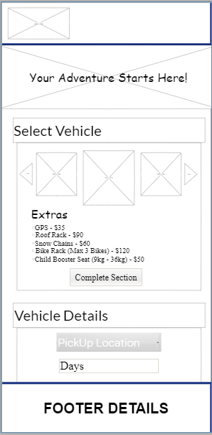
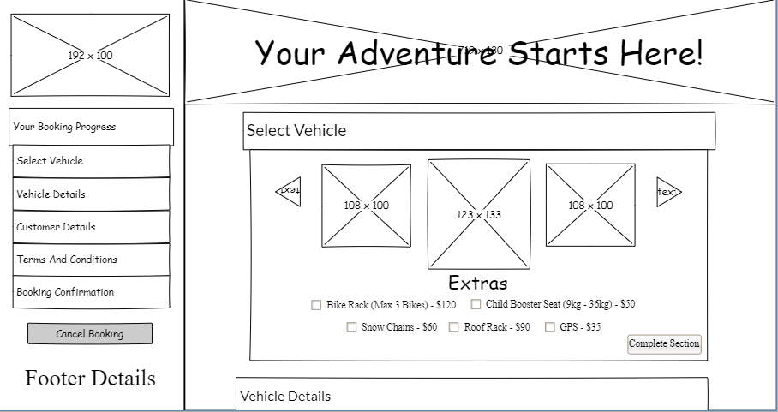
STEP 2:IDEATE (LOW FIDELITY WIREFRAME)

Slide 9
WIREFRAME FEEDBACK

Slide 10
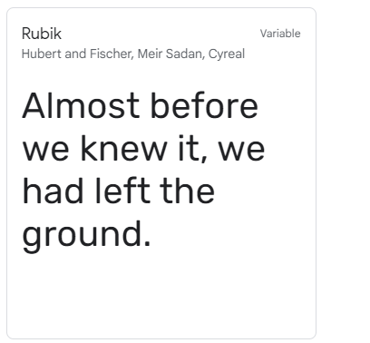
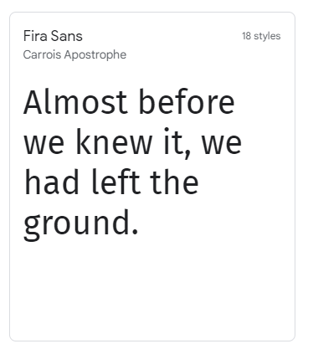
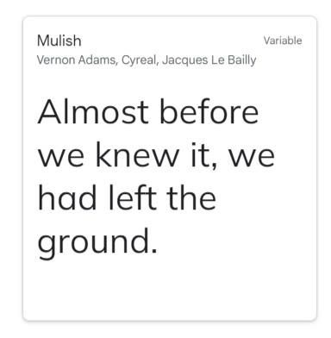
FONT COMBINATIONS
111
1111

Slide 11



COLOUR PALETTES
111
11
111

Slide 12
FEEDBACK ON FONTS/COLOURS

Slide 13
SITE SET UP

Slide 14
SET UP THE GUI

Slide 15
TRIALING INPUTS

Slide 16
Every LESSON – TAKE A SCREENSHOT OF YOU USING YOUR TRELLO BOARD – ADDING NOTES TO YOUR CARDS ETC AND A SCREENSHOT OF YOUR CODE AND GUI

Slide 17
TRIALING INPUTS

Slide 18
FEEBACK ON THE FUNCTIONALITY

Slide 19
FEEBACK ON THE ASETHETHICS

Slide 20
FEEBACK ON THE USABILILTY

Slide 21
TRIALING LAYOUTS

Slide 22
TRIALING OUTPUTS / ERROR MESSAGES

Slide 23
TRIALING OUTPUTS / ERROR MESSAGES

Slide 24
IMPROVING THE FUNCTIONALITY

Slide 25
TRIALING OUTPUTS / ERROR MESSAGES

Slide 26
DEBUGGING : WORKS ON EXPECTED DATA

Slide 27
DEBUGGING : WORKS ON EXPECTED DATA

Slide 28
DEBUGGING : WORKS ON EXPECTED DATA

Slide 29
DEBUGGING : WORKS ON EXPECTED DATA

Slide 30
DEBUGGING : WORKS ON EXPECTED DATA

Slide 31
DEBUGGING : WORKS ON BOUNDARY DATA

Slide 32
DEBUGGING : WORKS ON BOUNDARY DATA

Slide 33
DEBUGGING : WORKS ON INVALID DATA

Slide 34
DEBUGGING : WORKS ON INVALID DATA

Slide 35
FEEDBACK ON GUI

Slide 36
REFINEMENTS

Slide 37
REFINEMENTS

Slide 38
PHONE VS TABLES VS DESKTOP SCALING

Slide 39
REFINEMENTS

Slide 40
EVIDENCE OF CODE VALIDATION (HTML)

Slide 41
EVIDENCE OF CODE VALIDATION (CSS)

Slide 42
EVIDENCE OF CODE VALIDATION (JS)

Slide 43
EVIDENCE OF CODE COMMENTS (HTML/CSS/JS)

Slide 44
PERSISTENT STORAGE (FIREBASE DATABASE) SETUP

Slide 45
PERSISTENT STORAGE (FIREBASE DATABASE)
Firebase database

Slide 46
PERSISTENT STORAGE (FIREBASE DATABASE)
Final video of testing evidence / split screened GUI with Firebase

